Slide 1



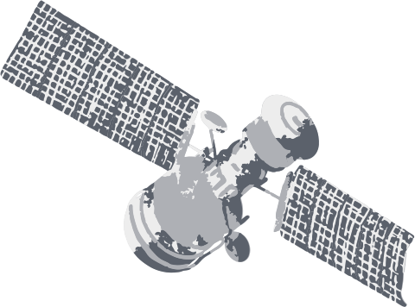

CubeSat Design Challenge

Slide 2




Carnegie Mellon University - Africa
CubeSat for Rwandan Agricultural Monitoring (C-RAM)
Team Artimis
Mohamed Alpha
Eudoxie Umwari
John Kakai
Mukama Francois
1
GROUP

Slide 3






Problem Statement & Mission Objective
PROBLEM: Rwandan agriculture faces challenges such as limited access to information, inefficient irrigation practices, and crop losses due to pests and diseases. These factors contribute to low productivity and hinder economic growth in the agricultural sector, which is a significant contributor to Rwanda's GDP.
THE MISSION: To improve agricultural productivity and efficiency in Rwanda by providing farmers with timely and accurate information on crop health, soil conditions, and weather patterns.

Slide 4

Payload & Data Collection
1
2
3
Hyperspectral Camera: Primary instrument for collecting detailed spectral data on crops and vegetation.
Multispectral Camera: Complements the hyperspectral data and provides wider coverage.
Processed data will be transmitted to ground stations in Rwanda for further analysis and dissemination to farmers.

Slide 5

CubeSat Design Overview
Hyperspectral Camera: Captures images in hundreds of narrow spectral bands to analyze crop health, identify diseases, and assess nutrient deficiencies.
Multispectral Camera: Provides additional data on vegetation indices and land cover classification.
Onboard Computer: Processes and stores data from the sensors, manages satellite operations, and controls communication.
Communication System: Ensures reliable data transmission to ground stations for analysis and distribution.
Power System: Triple-junction GaAs Cells: These are the most efficient type of solar cells currently available for CubeSats. They offer high efficiency (around 30%) and good radiation resistance, making them ideal for the harsh space environment.

Slide 6
Orbit & Mission Operations
The CubeSat will be placed in a Sun-synchronous orbit at an altitude of approximately 500-600 km. This orbit ensures consistent lighting conditions for image acquisition.

Slide 7
Orbit & Mission Operations
Orbit: C-RAM will be deployed in a Sun-synchronous orbit at an altitude of approximately 550 km. This orbit provides consistent illumination conditions for imaging and ensures regular coverage of Rwanda.
Revisit Time: The orbit will be designed for a revisit time of under 3 days, allowing for frequent monitoring of agricultural areas and capturing rapid changes in crop conditions.
Data Acquisition: The hyperspectral and multispectral imagers will capture images of farmland. Onboard processing will extract key information like vegetation indices and crop health indicators.
Data Transmission: Processed data will be transmitted to ground stations in Rwanda via S-band communication for analysis and dissemination to end-users.

Slide 8



Economic Impact
Improve Crop Management
Enhanced Resource Efficiency
Data Driven Solutions

Slide 9


Implementation Plan
1
Design, development, and testing of the CubeSat and ground station infrastructure.
2
Launch of the CubeSat into orbit using a commercial launch provider.
3
Data collection, processing, and analysis.
4
Development of a data dissemination platform (e.g., mobile app, web portal) to provide information to farmers.
5
Training and capacity building for farmers and agricultural extension workers to effectively utilize the data.

Slide 10


To empower Rwandan farmers with data-driven insights from a CubeSat, improving crop management and boosting agricultural productivity.
To empower Rwandan farmers with data-driven insights from a CubeSat, improving crop management and boosting agricultural productivity.
The Artimis C-RAM mission can empower farmers, improve agricultural practices, and contribute to sustainable economic growth in Rwanda.
Future Work are Constellation Expansion and regional collaboration.
Conclusion & Future Prospects

Slide 11
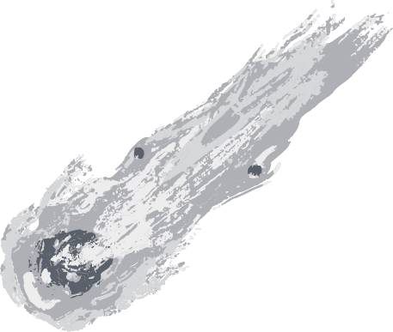




Thank You!

